Slide 1

Unsupervised Learning
경희대학교 컴퓨터공학과
2019102191 신주영

Slide 2
Table of Contents
PCA (Principal Component Analysis)
LSA (Latent Semantic Analysis)
NMF (Non-negative Matrix Factorization)
LDA (Latent Direchle Allocation)
K-Means Algorithm
Gaussian Mixture Model
LLE (Local Linear Embedding)
t-SNE (t-distributed stochastic neighbor embedding)

Slide 3
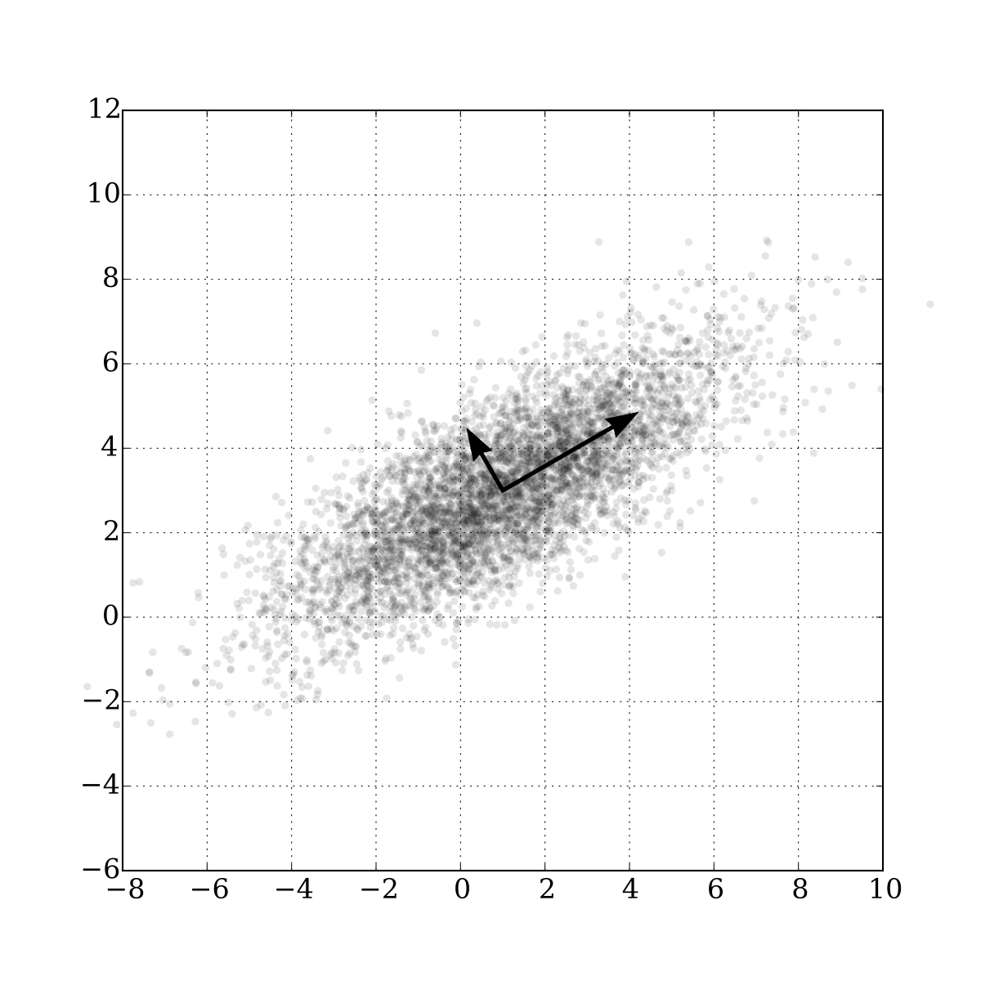
Fundamental Concept

Slide 4
Fundamental Concept
Using PCA, correlated multivariate data can be concisely represented as the main component.
PCA is a method used to reduce variables in data.
It is a representative dimension reduction method that can be applied to data that is correlated between variables.
Dimension reduction means 'It is expressed as several variables while maintaining the characteristics of data with many variables.'
It helps reduce complexity when analyzing multivariate data.

Slide 5
Fundamental Concept
Two ways to reduce variables
  Choose only important variables and do not use the remaining variables.
  constructing a new variable from the original data variable
PCA reduces variables by constructing a new variable from the original data variable
The data represented in a high-dimensional space is represented by a lower-dimensional variable.
We call lower-dimensional axis as a principal component

Slide 6
Fundamental Concept
Find the direction and importance necessary for data principal component analysis.
  The direction of the line is the direction of the data.
  Length represents importance.
    The direction of the data is determined by how much weight is assigned to the data variable when configuring a new variable.
    The importance of data is related to changes in variables.
The orthogonal line is used as a new axis and converted into original data.
  The changed data at this time is called the principal component score.
  It is called the first principal component and the second principal component from the value of the axis with the greatest importance among the principal components.

Slide 7
Algorithm
The principal component analysis calculates the principal component in the following order.
  Calculate variance covariance matrix
  Solve eigenvalue problems and calculate eigenvalue of eigenvectors
  Construct data in each principal component direction

Slide 8
Algorithm
Covariance
The covariance is a value representing the relationship between data points $x$ and $y$.
The mean was calculated after multiplying the difference between the mean and the data point of each of $x$ and $y$.
${Cov\left(x, y\right)=s}_{xy}=\frac{1}{n}\sum_{i=1}^{n}{(x_{i}−μ_{x})(y_{i}−μ_{y})}=E(X−μ_{x})(Y−μ_{y})$
In this case, $μ$ represents the average of each of $X$ and $Y$.
If $Cov\left(x, y\right)>0$ than $X$ increases, so does $Y$.
If $Cov\left(x, y\right)<0$ than $X$ increases, $Y$ decreases.
If $Cov\left(x, y\right)=0$ than $X$ and $Y$ has no correlation.

Slide 9
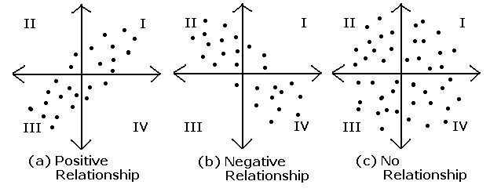
Algorithm
Covariance

Slide 10
Algorithm
Correlation
An index that does not depend on the size of the variance represents a correlation coefficient.
The covariance $s_{xy}$of the two data $x$ and $y$ is divided by the standard deviations $s_{x}$ and $s_{y}$.
$r_{xy}=\frac{s_{xy}}{s_{x}s_{y}}$
The correlation coefficient represents the relationship between data like covariance, but since it is divided by each standard deviation, a value between -1 and 1 is obtained.

Slide 11
Algorithm
Covariance Matrix
The covariance matrix is made into a matrix by calculating the covariance of each of the two or more data.
$\sum{=\left[\begin{matrix}s_{x_{1}x_{1}} & ⋯ & s_{x_{1}x_{n}} \\ ⋮ & ⋱ & ⋮ \\ s_{x_{n}x_{1}} & ⋯ & s_{x_{n}x_{n}}\end{matrix}\right]}$
$s_{x_{i}x_{j}}$represents the covariance of data point $x_{i}$ and $x_{j}$

Slide 12
Algorithm
Correlation Matrix
The correlation matrix is made into a matrix by calculating the correlation of each of the two or more data.
$\sum{=\left[\begin{matrix}r_{x_{1}x_{1}} & ⋯ & r_{x_{1}x_{n}} \\ ⋮ & ⋱ & ⋮ \\ r_{x_{n}x_{1}} & ⋯ & r_{x_{n}x_{n}}\end{matrix}\right]}$
$r_{x_{i}x_{j}}$represents the correlation of data point $x_{i}$ and $x_{j}$

Slide 13
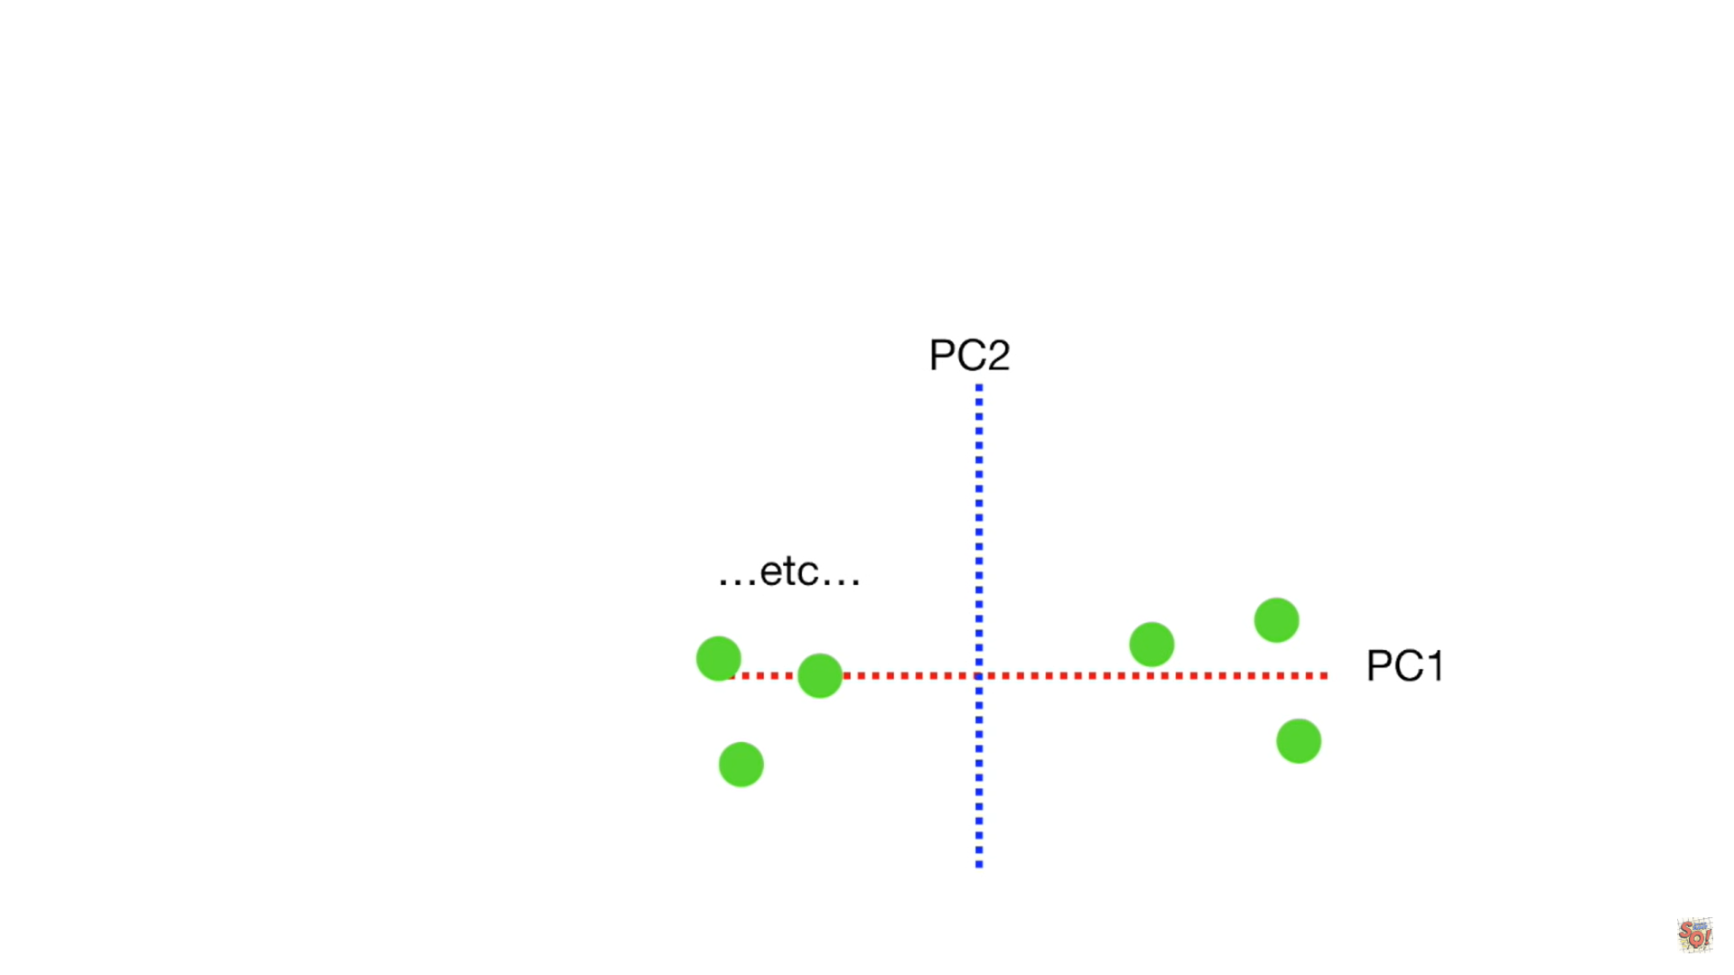
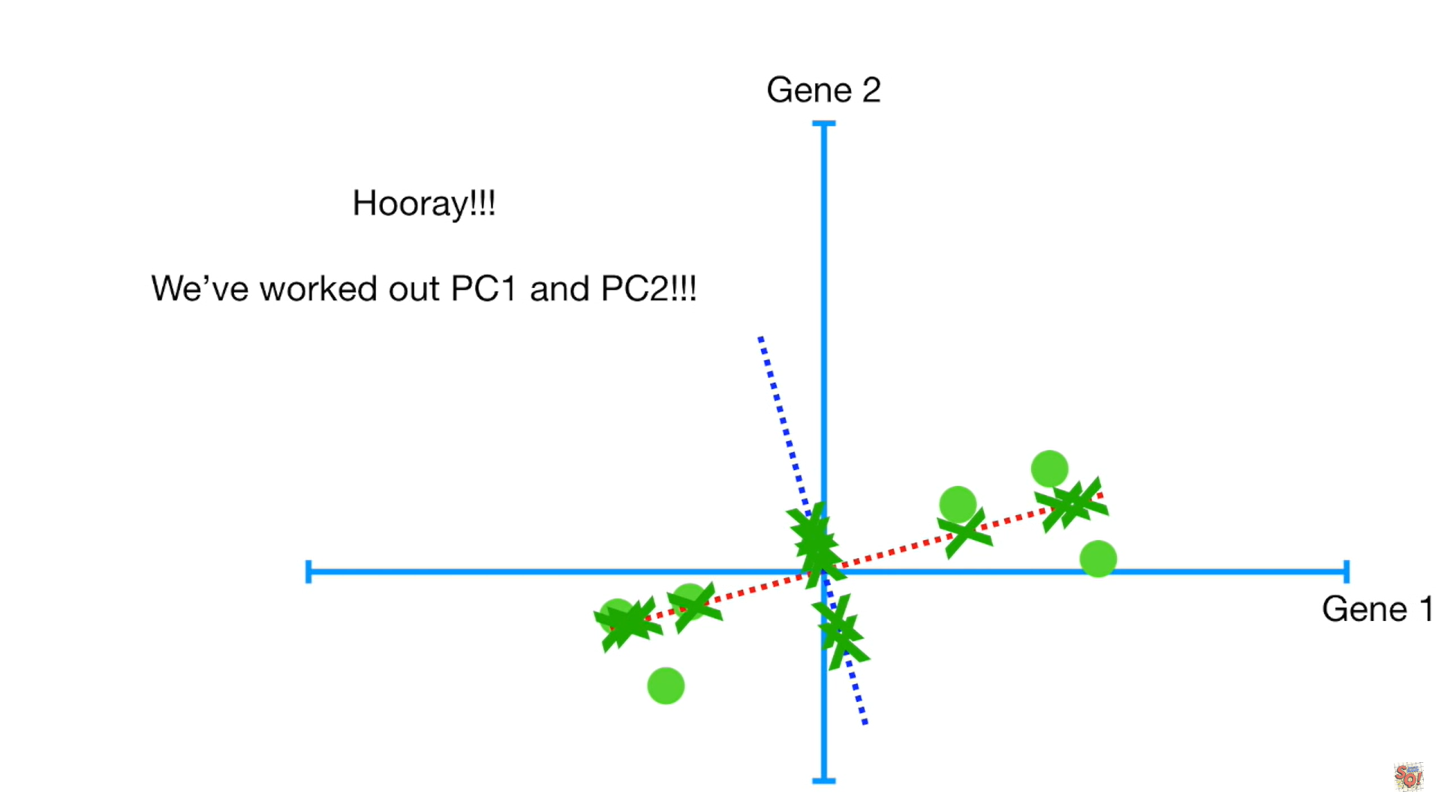
Algorithm

Slide 14
Algorithm
The direction of the data is related to the eigenvector.
The importance of data is related to eigenvalues.
If the eigenvalue calculated for each principal component is divided by the total sum of several eigenvalues, the importance of the principal component can be expressed as a ratio, which is called the contribution rate.
The value obtained by adding the contribution rate sequentially from the first main component is called the cumulative contribution rate.

Slide 15
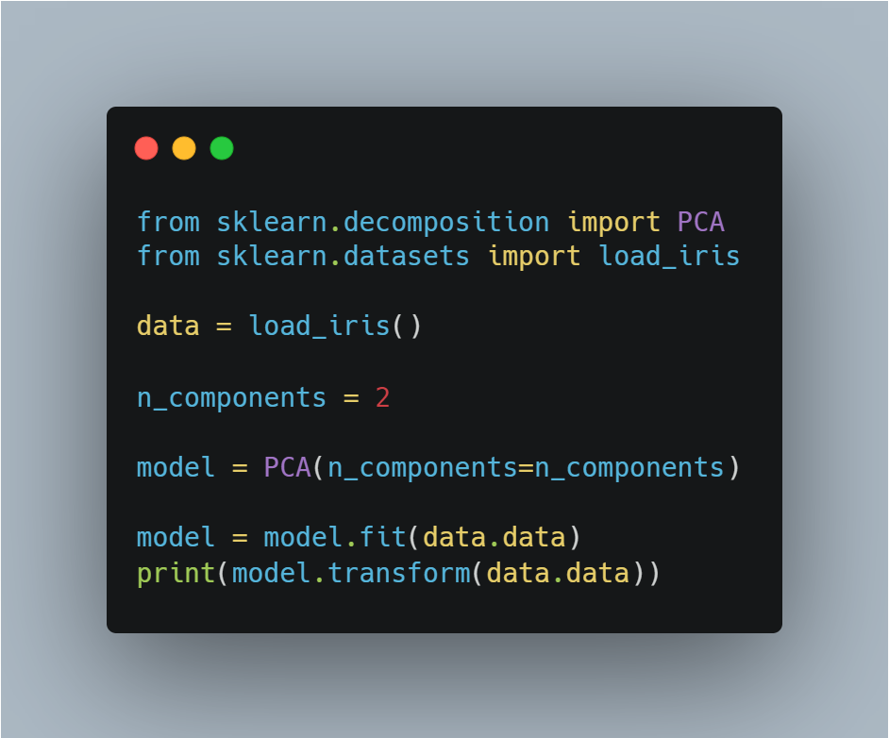
Sample Code
Import libraries
Get iris dataset
Make PCA model
Train data into model
Print transformed data

Slide 16
Unsupervised Learning
Latent Semantic Analysis, LSA
경희대학교 컴퓨터공학과
2019102191 신주영

Slide 17
Fundamental Concept
It is used in the field of data information retreival
By using LSA, we can see the latent relevance of words from a large amount of document data.

Slide 18
Algorithm
Convert the sentence below to matrix X
  자동차로 회사에 출근했다.
  차로 출근했다.
  레스토랑에서 햄버거를 먹는다.
  레스토랑에서 파스타를 먹는다.
 | 문장1 | 문장2 | 문장3 | 문장4
자동차 | 1 | 0 | 0 | 0
회사 | 1 | 0 | 0 | 0
출근 | 1 | 1 | 0 | 0
차 | 0 | 1 | 0 | 0
레스토랑 | 0 | 0 | 1 | 1
햄버거 | 0 | 0 | 1 | 0
먹다 | 0 | 0 | 1 | 1
파스타 | 0 | 0 | 0 | 1

Slide 19
Algorithm
Decompose the matrix X.
  The matrix X, which is an 8X4 matrix, is represented by the product of the 8X4 matrix U, the 4X4 matrix D, and the 4X4 matrix V^T.
    Matrix U: Matrix with transformation information of characteristics made of words
    Matrix D: Matrix with information importance
    Matrix V: Matrix with word features and document conversion information
$X=UDV^{T}=\begin{matrix}0.00 & −0.45 & −0.45 & 0.00 \\ 0.00 & −0.45 & −0.45 & 0.00 \\ ⋮ & ⋮ & ⋮ & ⋮ \\ −0.32 & 0.00 & 0.00 & −0.71\end{matrix}×\begin{matrix}2.24 & 0 & 0 & 0 \\ 0 & 1.90 & 0 & 0 \\ 0 & 0 & 1.18 & 0 \\ 0 & 0 & 0 & 1.00\end{matrix}×\begin{matrix}0.00 & 0.00 & −0.71 & −0.71 \\ −0.85 & −0.53 & 0.00 & 0.00 \\ −0.53 & 0.85 & 0.00 & 0.00 \\ 0.00 & 0.00 & 0.71 & −0.71\end{matrix}$

Slide 20
Algorithm
The matrix D is a diagonal matrix. Diagonal elements list values in order of greater importance of information.
Therefore, if we reduce the dimension to three matrices, we should look at D carefully.
Since the original data has four features, let's say that the dimension is reduced to two features.

Slide 21
Algorithm
From the diagonal element values of a matrix D with four features, choose two elements of greater importance to form a 2X2 diagonal matrix.
The other two matrices are also changed to correspond to the elements selected in D.
The matrix U deletes the entire elements of the third and fourth columns and replaces them with an 8X2 matrix.
The matrix V^T deletes all elements of the third and fourth rows to form a 2X4 matrix.
$\hat{X}=\hat{U}\hat{D}{\hat{V}}^{T}=\begin{matrix}0.00 & −0.45 \\ 0.00 & −0.45 \\ ⋮ & ⋮ \\ −0.32 & 0.00\end{matrix}×\begin{matrix}2.24 & 0 \\ 0 & 1.90\end{matrix}×\begin{matrix}0.00 & 0.00 & −0.71 & −0.71 \\ −0.85 & −0.53 & 0.00 & 0.00\end{matrix}$

Slide 22
Algorithm
Table of 2 features divided by latent variables
 | A | B
자동차 | 0.00 | 0.85
회사 | 0.00 | 0.85
출근 | 0.00 | 1.38
차 | 0.00 | 0.53
레스토랑 | 1.41 | 0.00
햄버거 | 0.71 | 0.00
먹다 | 1.41 | 0.00
파스타 | 0.71 | 0.00

Slide 23
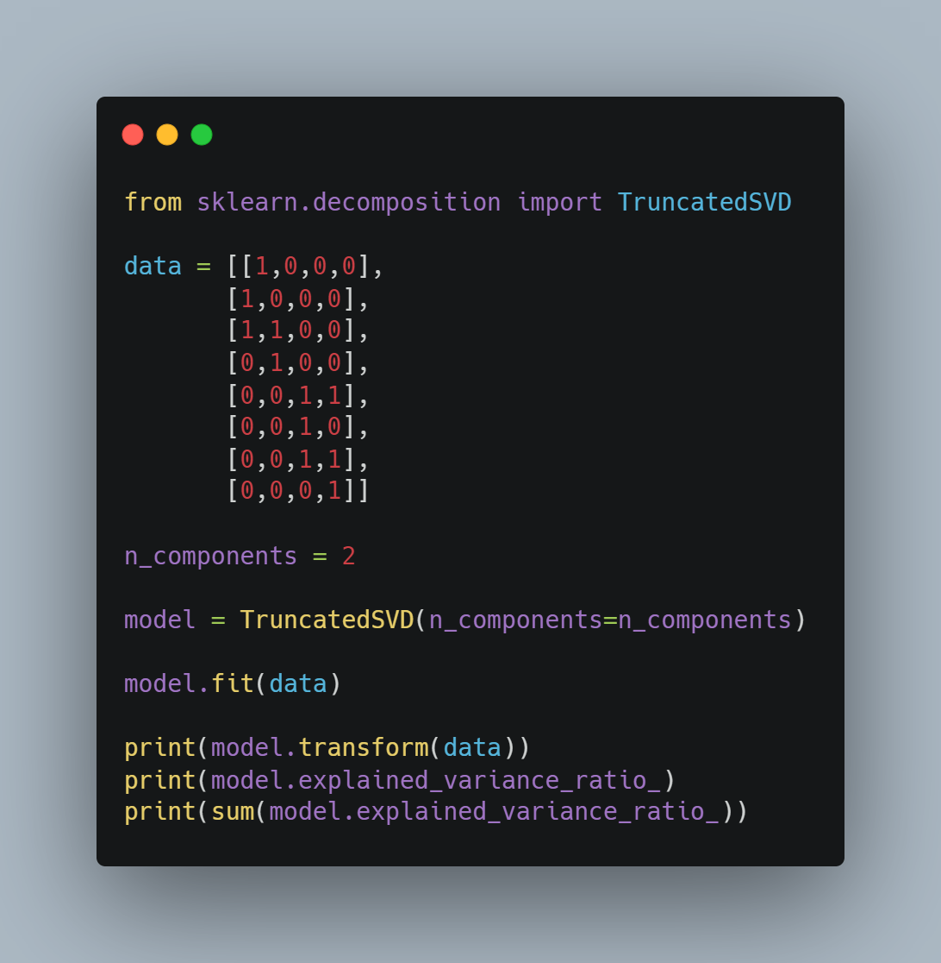
Sample Code
Import library
Set data
Set dimension to reduce
Print transformed data
Print Contribution Rate

Slide 24
Points to note
It is difficult to properly explain the relevance of words with the converted matrix. If each dimension is orthogonal or the matrix element is negative, it is difficult to properly explain the relevance.
The calculation can take a very long time.

Slide 25
Unsupervised Learning
Non-negative Matrix Factorization, NMF
경희대학교 컴퓨터공학과
2019102191 신주영

Slide 26
Fundamental Concept
NMF is a dimensionality reduction method in which features and labels are both positive.
Easy to model when dealing with image data, etc
It is an algorithm that is applied only when all the components of the original matrix are positive.
  The original matrix element must be positive.
  After matrix decomposition, the matrix element is positive.
  In NMF, there is no restriction that each dimension is orthogonal.

Slide 27
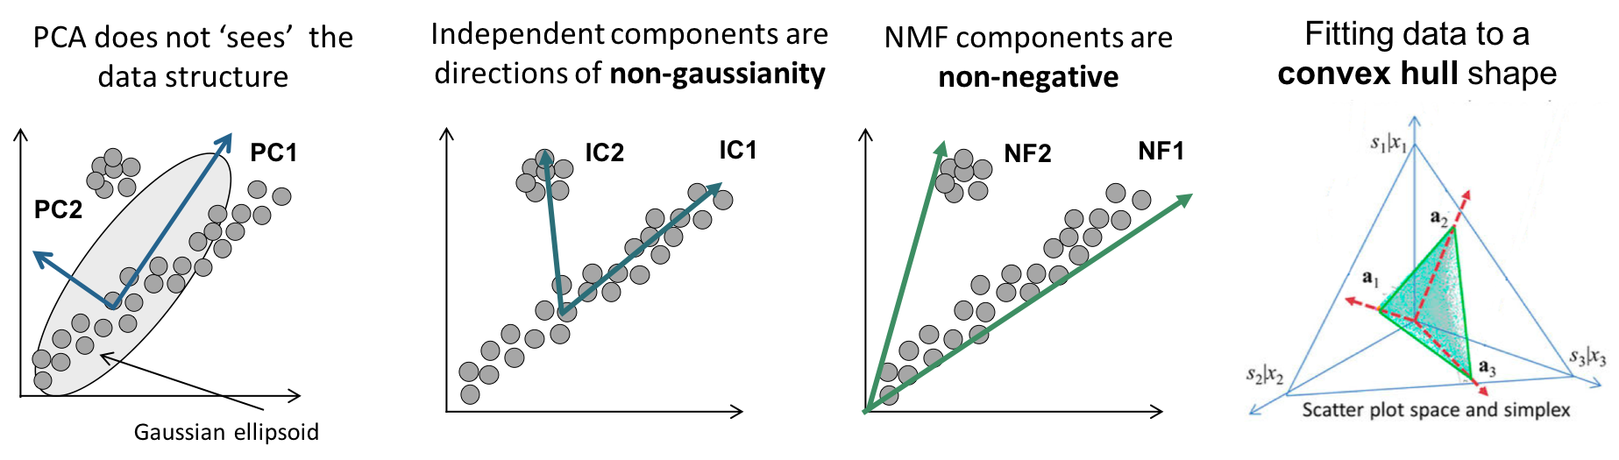
Fundamental Concept
PCA always uses orthogonal eigenvectors, making it difficult to find associations between data, but NMF can grasp the nature of the data.

Slide 28
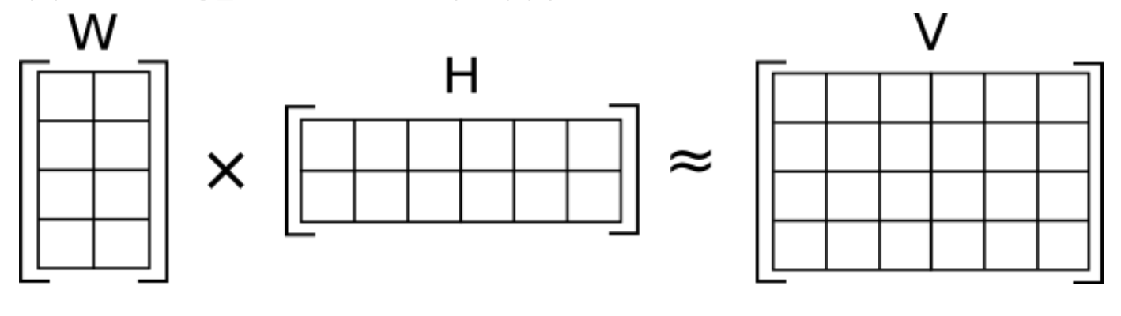
Fundamental Concept
NMF do dimensionality reduction by decompose original data to 2 matrix

Slide 29
Fundamental Concept
Calculation Process
  Initialize W, H as a positive value
  Treat H as a constant and renew W
  Treat W as a constant and renew H
  End calculation when W, H converges to the original matrix

Slide 30
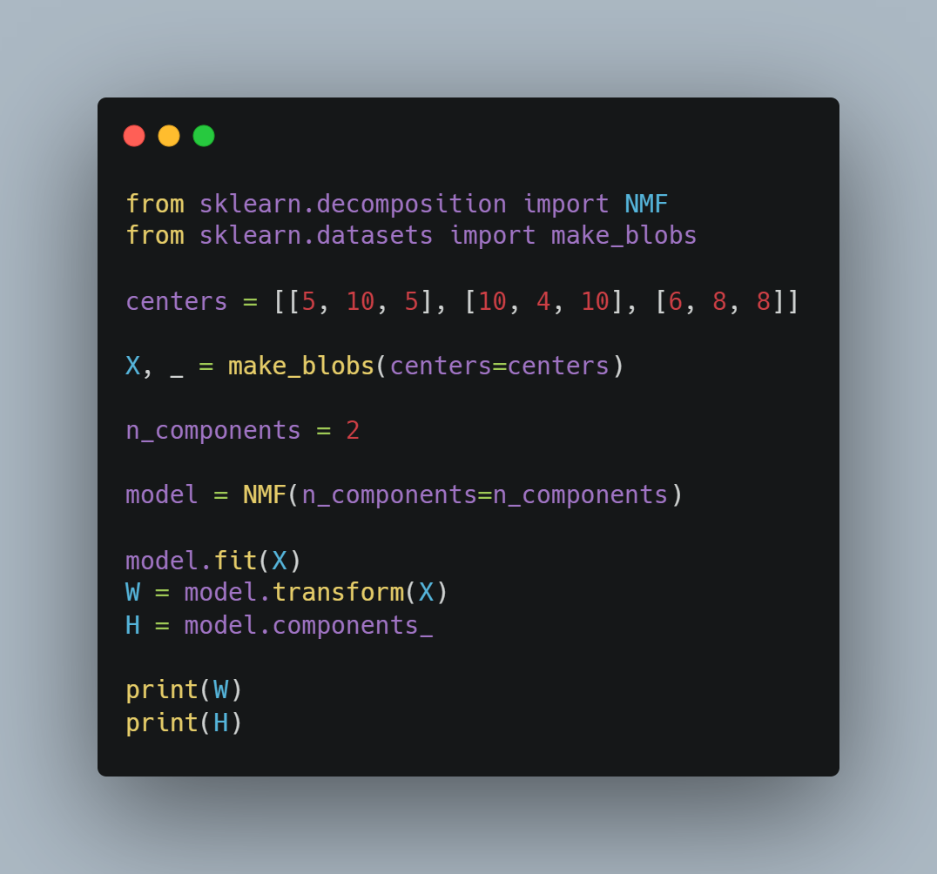
Sample Code
Imort libraries
Set data
Set dimension to reduce
Make model
Train data
Print W matrix and H matrix

Slide 31
Unsupervised Learning
Latent Dirichlet Allocation, LDA
경희대학교 컴퓨터공학과
2019102191 신주영

Slide 32
Fundamental Concept
One of the dimensional reduction methods suitable for modeling documents.
Various topics can be covered by using words in the document as input data.
It is used in NLP, etc
Create latent topics with the words in the document to indicate what each document is composed of.
You can explain that there are multiple topics in a document.

Slide 33
Algorithm
Assign a topic randomly to each word in a document
Calculate the probability of each topic in a document from the topic you assign to the word
Calculate the probability of words by topic from the topic you assign to the word
Reassign the topic to each word in the document with the probability of multiplying by 2 and 3
Repeat courses 2 through 4 until converging conditions

Slide 34
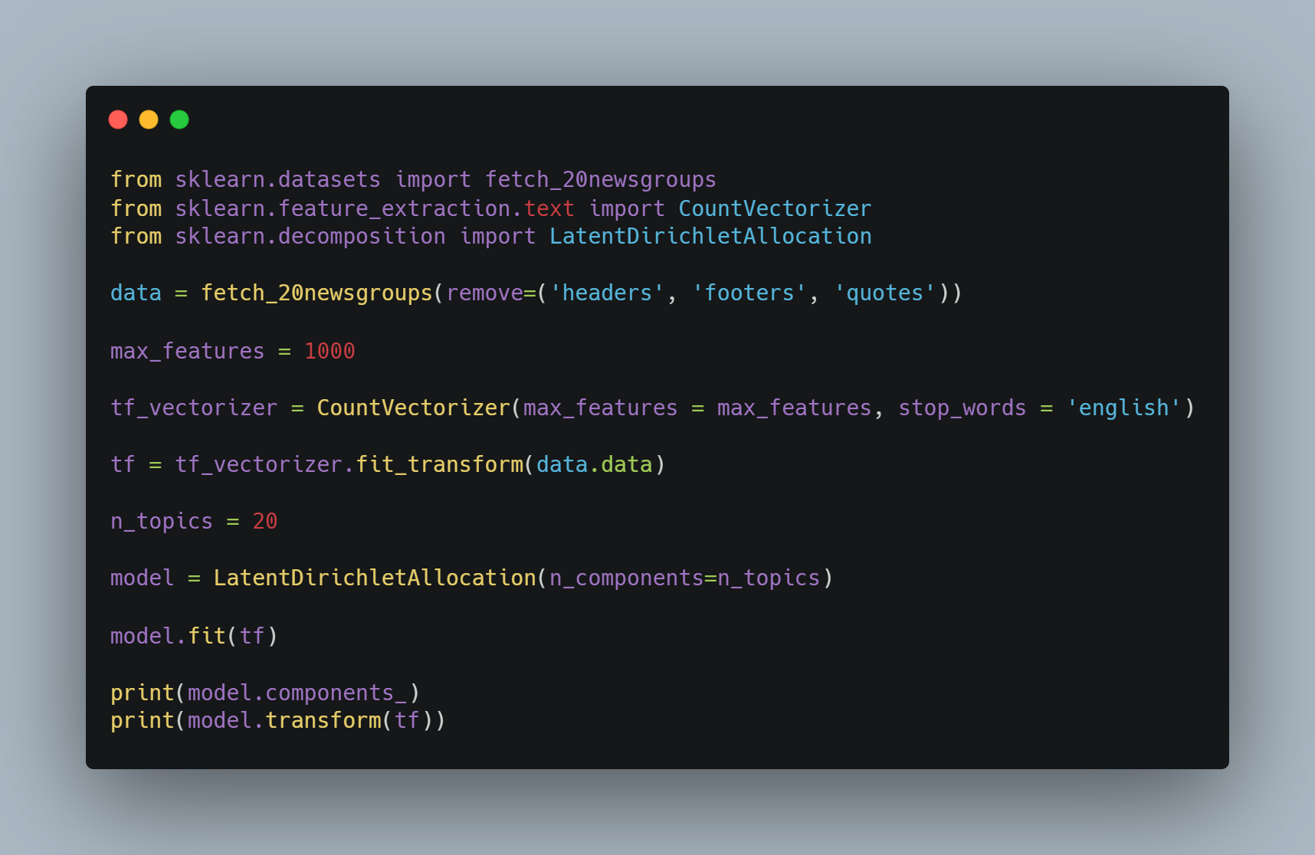
Sample Code
Import libraries
Make dataset
Set max feature
Set stop words
Train data
Print results

Slide 35
Disposal of stop word
Topic 4
:00 10 25 15 12 11 16 20 14 13 18 30 50 17 55 40 21 ...
Topic 6
:people said know did don didn just time went like say think told
As described above, the distribution of topics that are difficult to intuitively explain the topic can be improved by learning to exclude stop word.

Slide 36
Unsupervised Learning
K-Means Algorithm
경희대학교 컴퓨터공학과
2019102191 신주영

Slide 37
Fundamental Concept
A method of dividing data of similar characteristics into groups is called clustering.
The group to which the data points belong is determined as the group whose distance between the data points and the center of each group is closest.
Determining the center of this group is an important operation of the K-means algorithm.

Slide 38
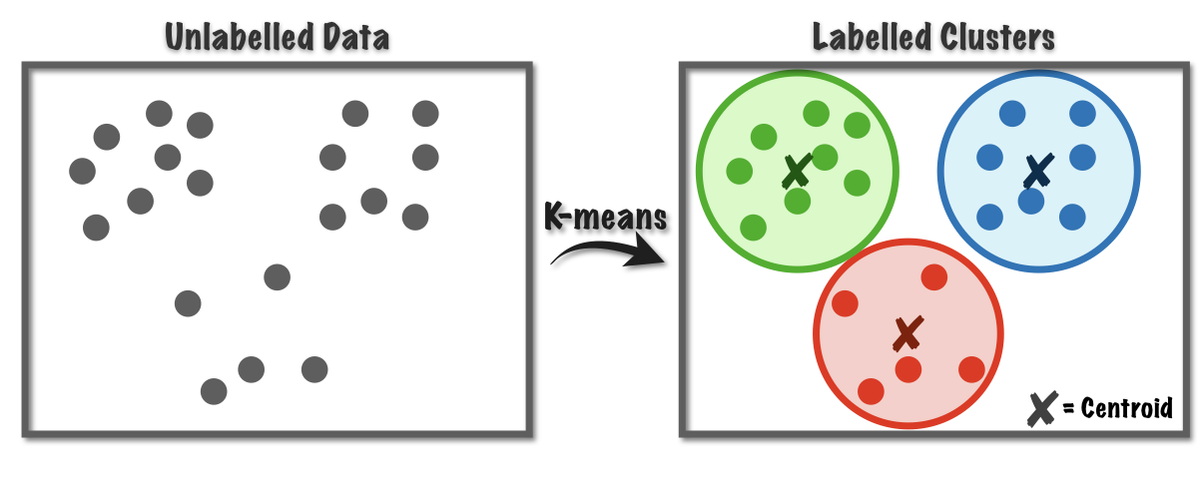
Fundamental Concept

Slide 39
Algorithm
K-means algorithm's learning process
  Choose and center the appropriate number of data pointers by the number of groups
  Calculates the distance between a data point and each center to determine the nearest center as the group to which that data point belongs
  Average data points for each group and set them as new centers
  Repeat steps 2-3 until convergence

Slide 40
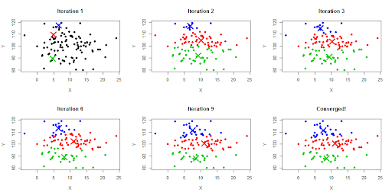
Algorithm

Slide 41
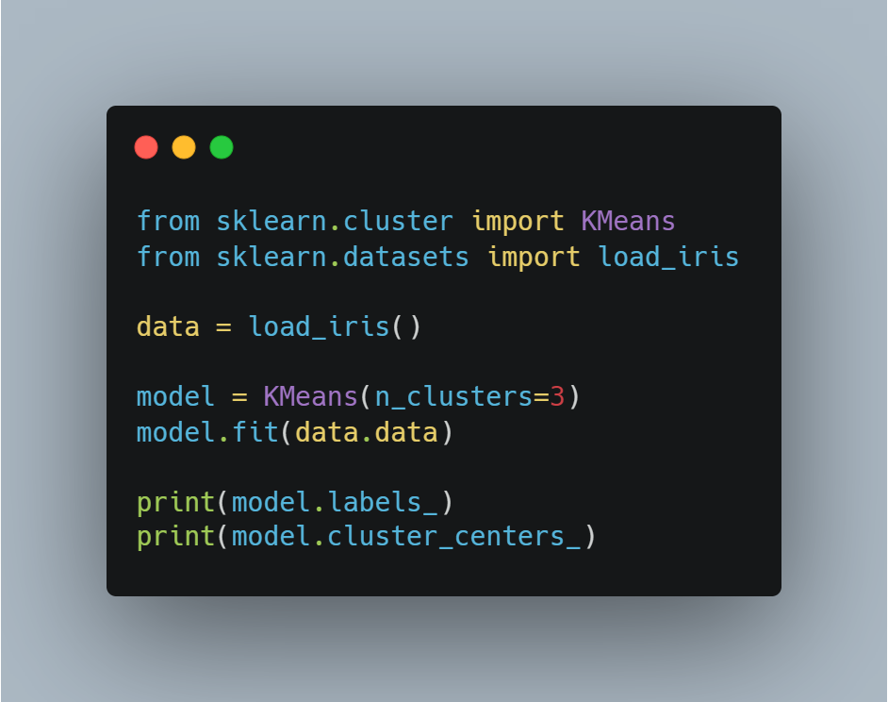
Sample Code
Import libraries
Load iris dataset
Make K-Means model
Set n_cluster
Fit data
Print labels
Print cluster’s center

Slide 42
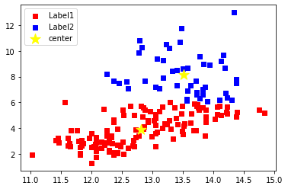
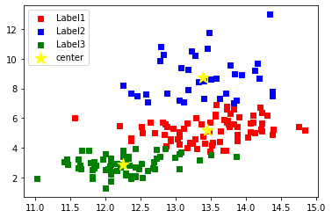
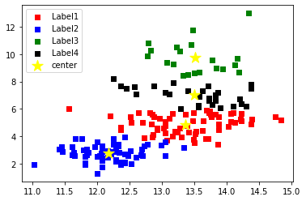
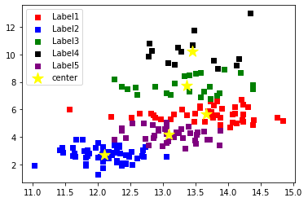
Visualization according to n_clusters (using sepal length and sepal width)

Slide 43
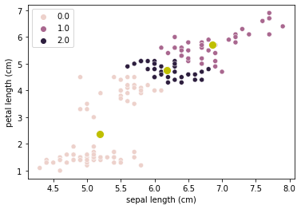
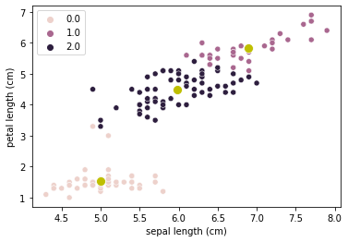
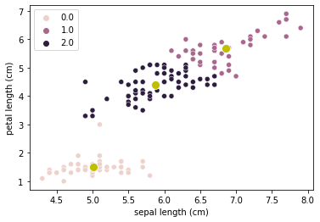

Visualization according to iteration (using sepal length and petal length)
1st iteration
2nd iteration
3rd iteration
4th iteration

Slide 44

Within-cluster sum of squares, WCSS
The good or bad of clustering is evaluated quantitatively by calculating the WCSS.
The smaller the distance between the center of the group and the data point belonging to the group, the smaller the WCSS value.

Slide 45
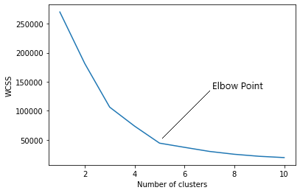
WCSS elbow method
The number of clusters can be determined using the WCSS elbow-method.
Determine the number based on the point on the graph that looks like an elbow.

Slide 46
Over-fitting in unsupervised learning
If there are too many clusters for a particular dataset, a generalized model is not created.
For example, there are three actual types of iris varieties, but setting the cluster to five creates an unsuitable model.

Slide 47
Unsupervised Learning
Gaussian mixture model
경희대학교 컴퓨터공학과
2019102191 신주영

Slide 48
Fundamental Concept
It is used in clustering
The data distribution is represented using the mean and variance of the data.
The Gaussian distribution is mixed to represent complex data consisting of several groups.

Slide 49
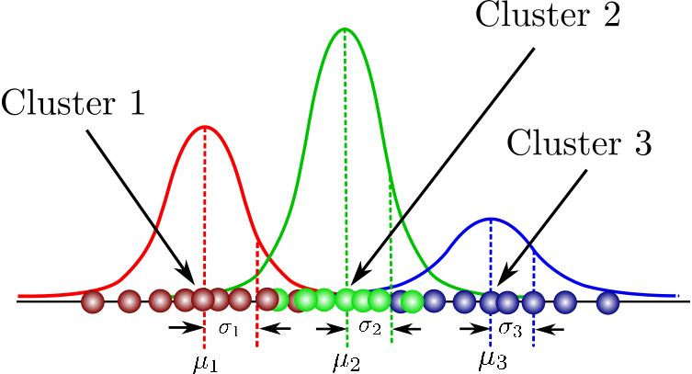
Fundamental Concept

Slide 50
Algorithm
The Gaussian mixture model calculates the mean and variance for each Gaussian distribution at the data point.
  Initialize the mean and variance of each Gaussian distribution
  Calculate the weight of each data point from group to group
  Recompute parameters with weights obtained in course 2
  Repeat Steps 2 and 3 until each change in the average updated in Course 3 is sufficiently small

Slide 51
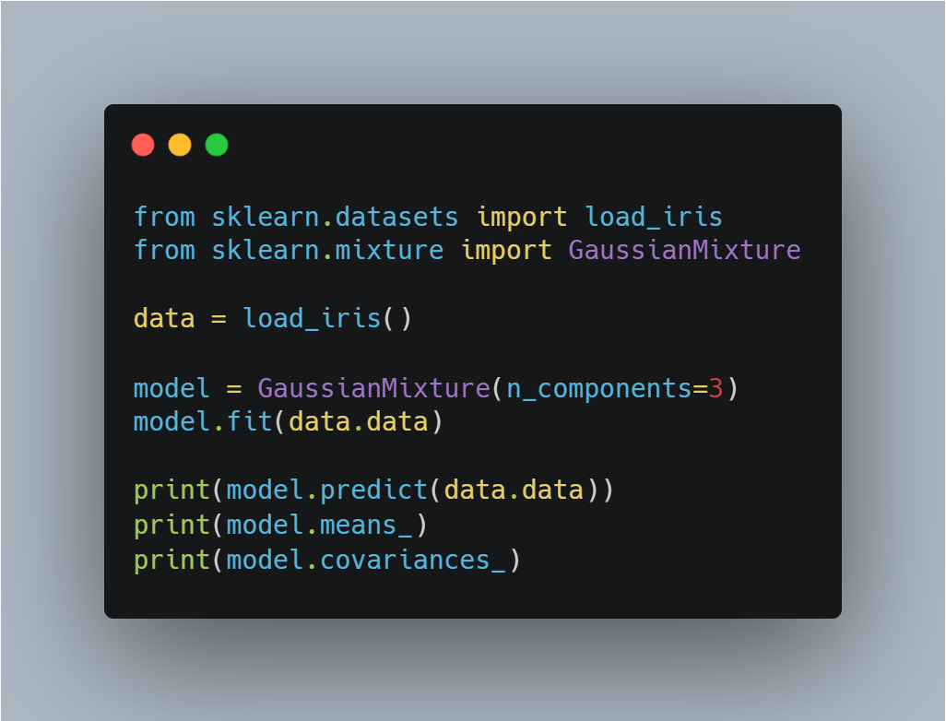
Sample Code
Import libraries
Make Gaussian mixture model instance
Train data
Print predicted data
Print means
Print covariances

Slide 52
Unsupervised Learning
Local Linear Embedding, LLE
경희대학교 컴퓨터공학과
2019102191 신주영

Slide 53
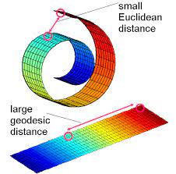
A Dictionary Concept
manifold: The low-dimensional manifold is a low-dimensional shape bent or twisted in a high-dimensional space.

Slide 54
Fundamental Concept
LLE is an algorithm that represents a curved or twisted structure in a high-dimensional space as a simple structure in a low-dimensional space.
LLE is one of the manifold learnings that dimensionally reduce data of nonlinear structures.
LLE takes out the 2D structure hidden in the 3D space and represents it as 2D data.

Slide 55
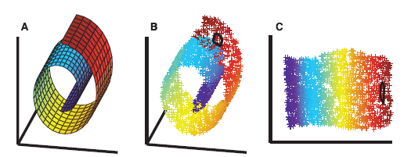
Fundamental Concept

Slide 56
Fundamental Concept
Three steps in LLE
  Construct kNN graph
  Calculate the reconstruction of weights for reconstructing every point by its neighbors
  Use the obtained weights to embed the points in the low dimensional subspace

Slide 57
Algorithm
Training data: ${\{x_{i}∈ℝ^{d}\} }_{i=1}^{n}, X=[x_{1},…,x_{n}]∈ℝ^{d×n}$
j–th neighbor of ${x_{i} : x}_{ij}∈ℝ^{d}, X_{i}=[x_{i1},…,x_{ik}]∈ℝ^{d×k}$
Test dataset: ${\{x_{i}^{(t)}∈ℝ^{d}\} }_{i=1}^{n_{t}}, X^{(t)}=[x_{1}^{(t)},…,x_{n_{t}}^{(t)}]∈ℝ^{d×n_{t}}$
Training neighbors of $x_{i}$: $X^{(t)} : X_{i}^{(t)}:=[x_{i1}^{(t)},…,x_{ik}^{(t)}]∈ℝ^{d×k}$ $x_{i}$

Slide 58
Algorithm
LLE step 1
Linear regional relationship modeling.
Fix the sample and find the optimal weight.
$$\hat{W}=argmin\sum_{i=1}^{m}{{(x^{\left(i\right)}−\sum_{j=1}^{m}{w_{i, j}X^{(j)})}}^{2}}$$
$[조$건]$\left\{{}_{\sum_{j=1}^{m}{w_{i,j}=1}}^{w_{i, j=0}}{{}_{i=1, 2, 3, …, m일 때 }^{X^{\left(j\right)}가 X^{(i)}의 최근접 이웃 k개 중 하나가 아닐 때}{}}\right.$

Slide 59
Algorithm
LLE step 2
Reduce the dimension of preserving relationships
Fix the weights and find the optimal location of the sample image in the low-dimensional space.
$$Z=argmin\sum_{i=1}^{m}{{(Z^{\left(i\right)}−\sum_{j=1}^{m}{{\hat{w}}_{i, j}Z^{(j)})}}^{2}}$$

Slide 60
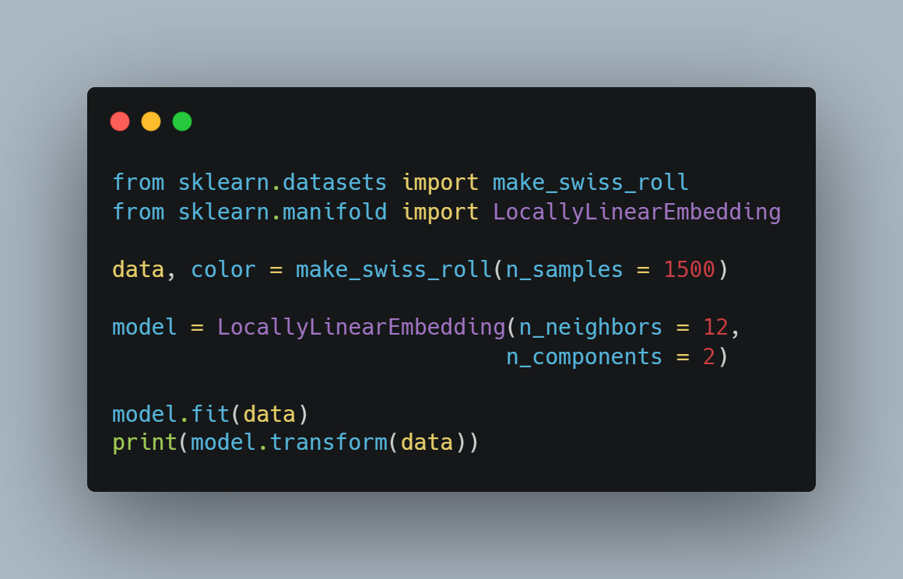
Sample Code
Import libraries
Make dataset
Set n_neighbors and dimension
Train data
Print result

Slide 61
Unsupervised Learning
t-distributed stochastic neighbor embedding, t-SNE
경희대학교 컴퓨터공학과
2019102191 신주영

Slide 62
Fundamental Concept
It is a method of dimensionally reducing complex data in high dimensions to two dimensions.
t-SNE is one of manifold learning and aims to visualize complex data.

Slide 63
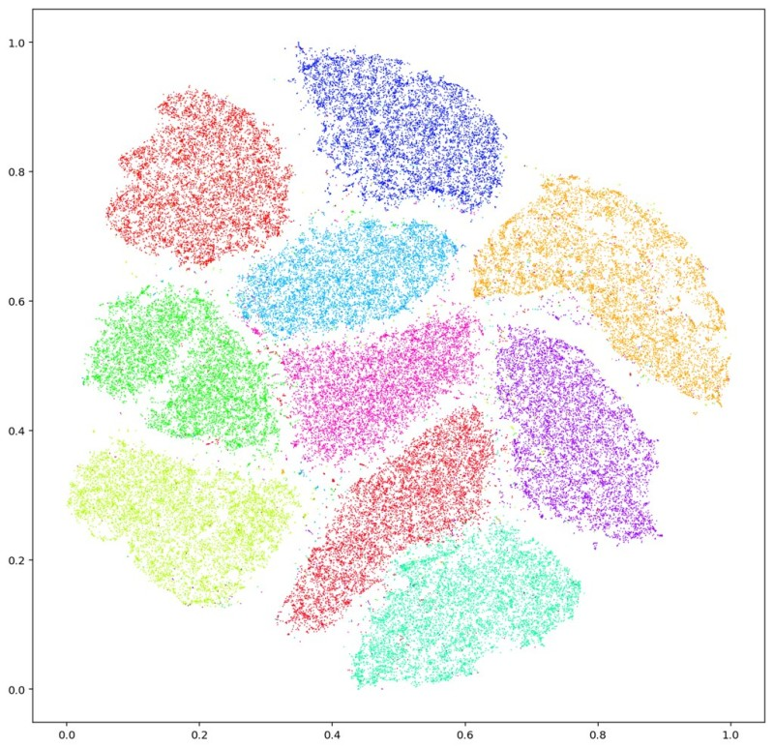
Fundamental Concept

Slide 64
Algorithm
t-SNE steps
  The similarity of $x_{i}$ and $x_{j}$ for all $i$ and $j$ pairs is expressed as similarity using Gaussian distribution.
  We randomly place the same number of points $y_{i}$as $x_{i}$ in a low-dimensional space, and show the similarities of $y_{i}$ and $y_{j}$ for all $i$ and $j$ pairs using the t distribution.
  If possible, the data point $y_{i}$ is updated so that the similarity distribution defined in 1 and 2 is the same.
  Repeat step 3 until the convergence condition.

Slide 65
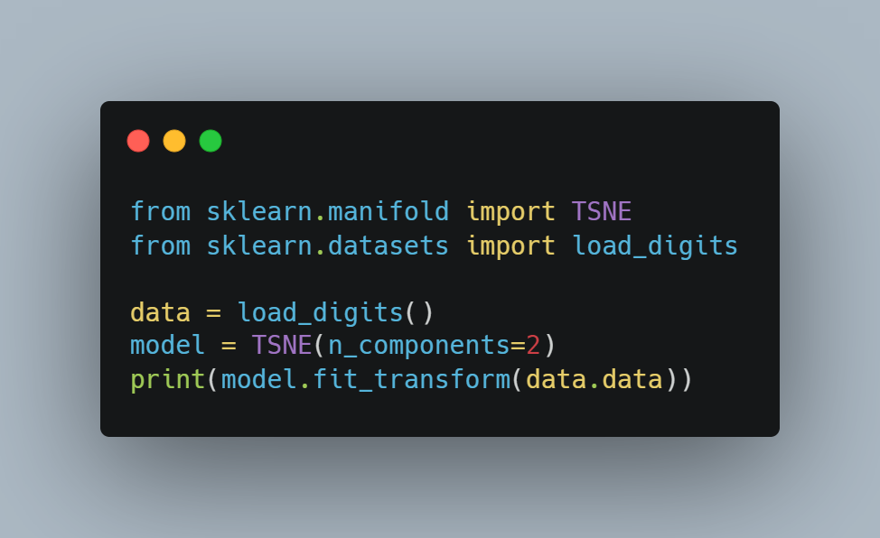
Sample Code
Import libraries
Load data
Make t-SNE model
Print result

Slide 66
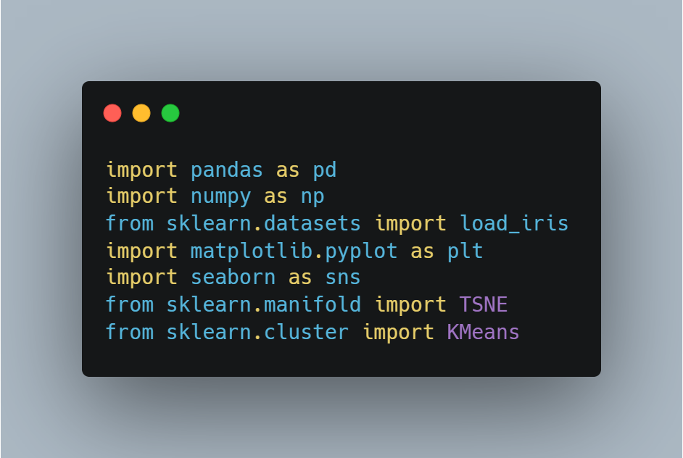
Application of t-SNE to K-Means using iris dataset
Import libraries
Pandas
Numpy
Sklearn
Matplotlib
Seaborn

Slide 67
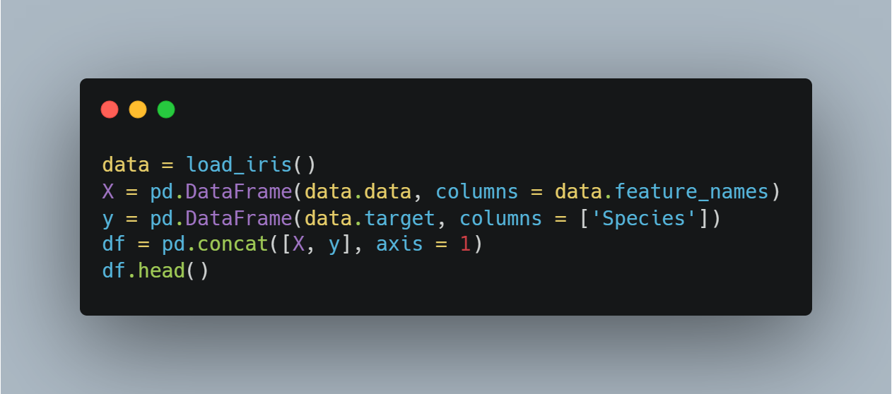
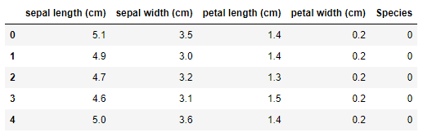
Application of t-SNE to K-Means using iris dataset
Make dataset

Slide 68
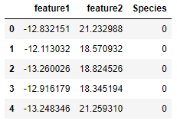
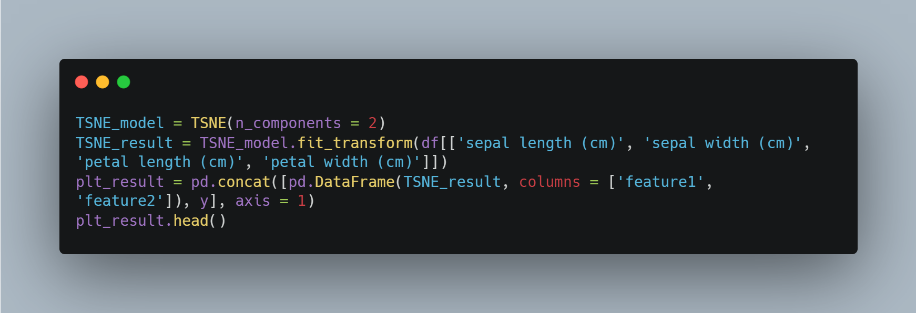
Application of t-SNE to K-Means using iris dataset
t-SNE result

Slide 69
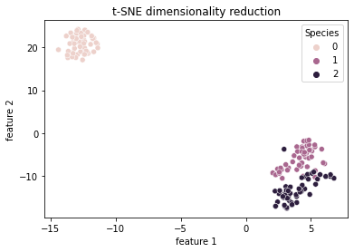
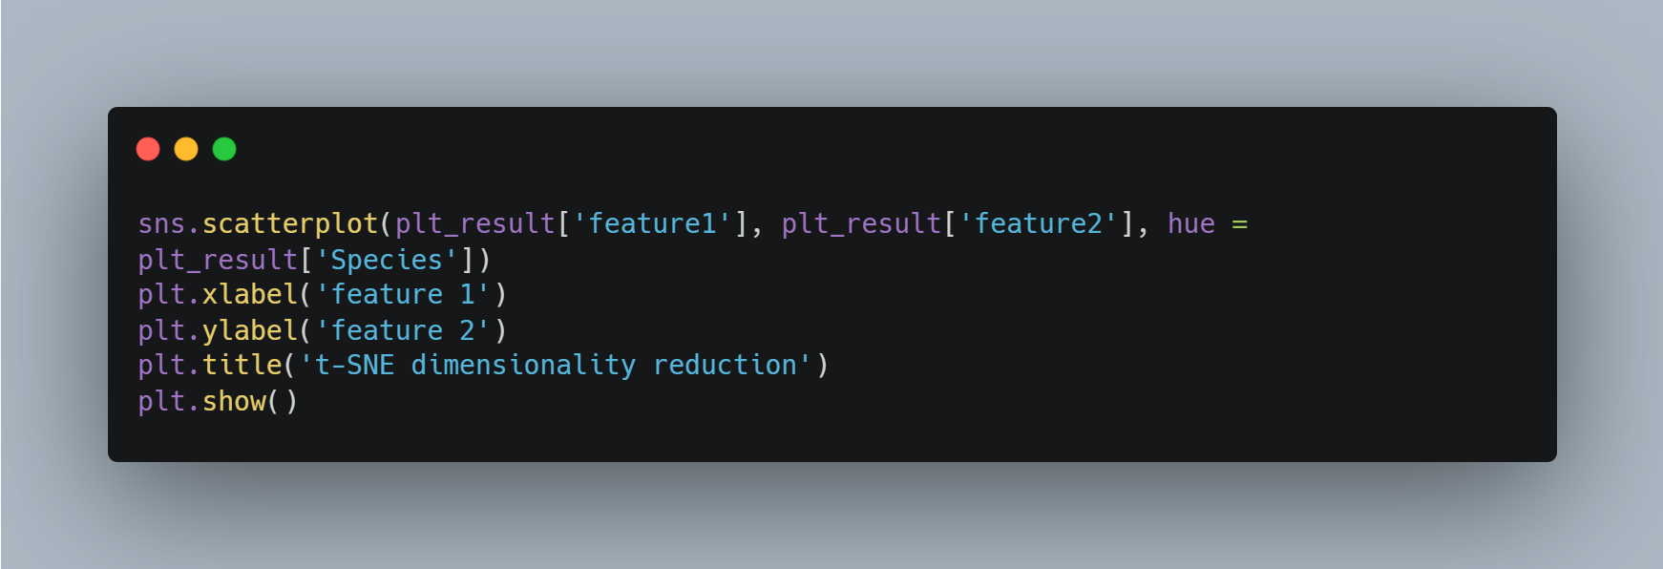
Application of t-SNE to K-Means using iris dataset
Actual iris data distribution

Slide 70
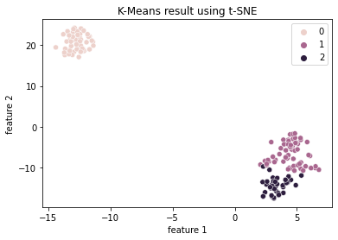
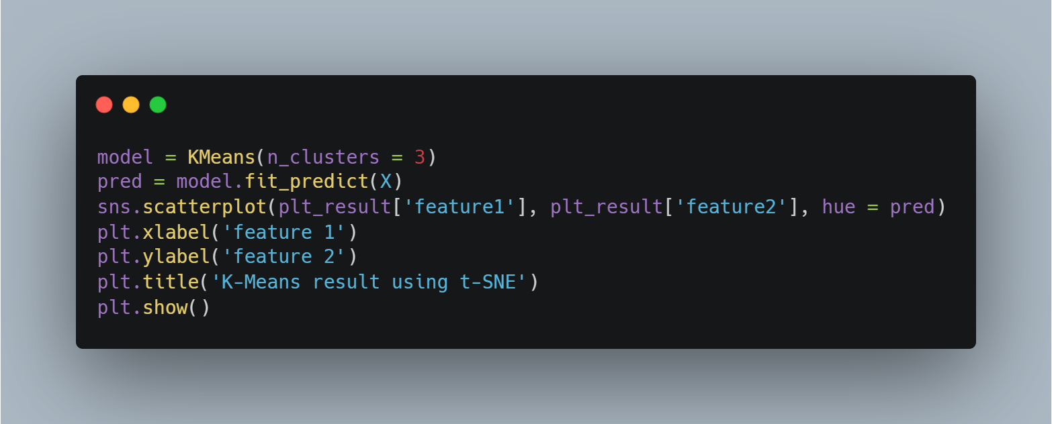
Application of t-SNE to K-Means using iris dataset
Predicted iris data distribution

